Slide 1
Thermometry of Non-Interacting Ultracold Fermi Gases
Casey Sobecks Project Defense For Master of Science

Slide 2
Contents
Cold Atom Experiments
Statistical Mechanics of Non-Interacting Identical particles
Recursive Solutions
Results
Conclusion

Slide 3
Contents
Cold Atom Experiments
Statistical Mechanics of Non-Interacting Identical particles
Recursive Solutions
Results
Conclusion

Slide 4
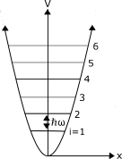
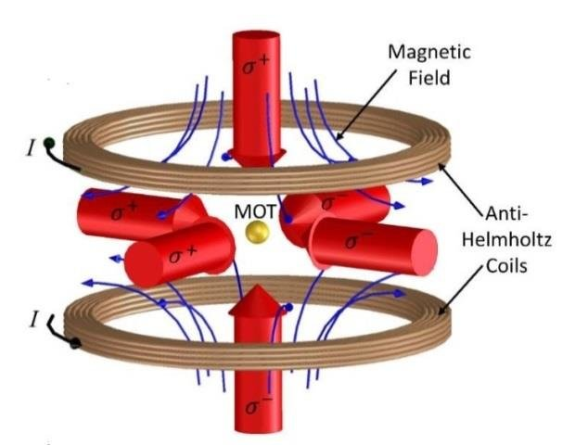
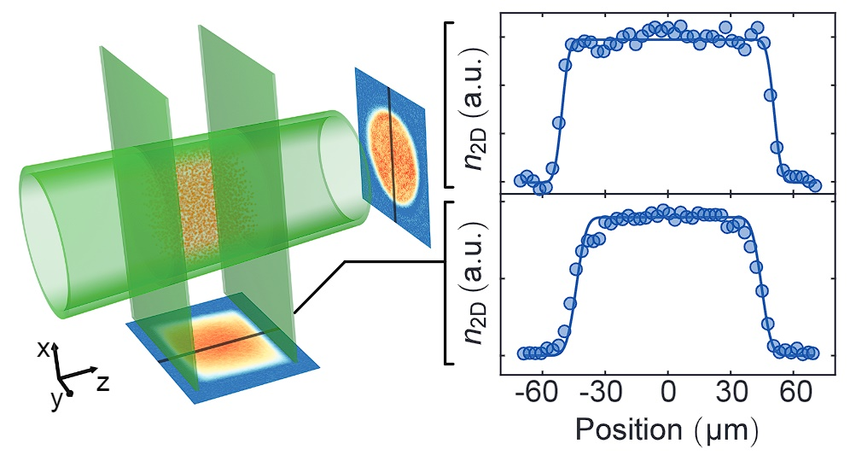
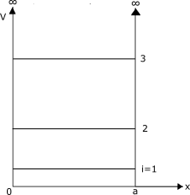
Quantum Mechanical Traps
In experiment, Cold atomic clouds are placed into a region with a potential
Magneto Optical Traps (MOTS)
Linear Energy Spectrum
Quadratic energy spectrum
Travagnin, Martino. (2021). Cold atom interferometry sensors: physics and technologies A scientific background for EU policymaking. 10.2760/315209.
Mukherjee et. al. (2017). Homogeneous Atomic Fermi Gases. 10.1103/physrevlett.118.123401
Notes:
Atom chip: n1 is atomic density, x is longitudinal position, T=4.16 microK

Slide 5
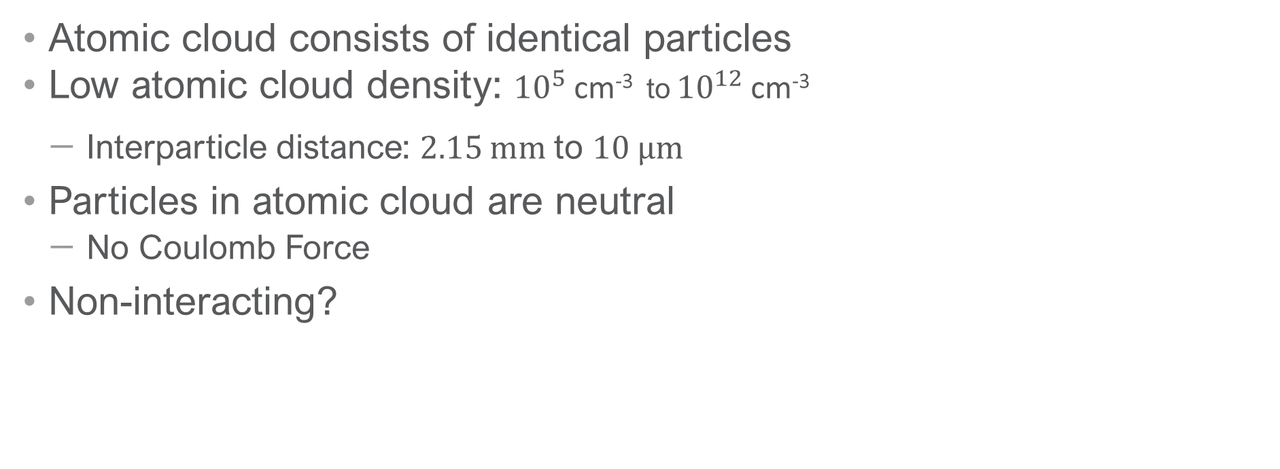
Atomic Gas
Atomic cloud consists of identical particles
Low atomic cloud density: ${10}^{5}$cm⁻³ to ${10}^{12}$cm⁻³
Interparticle distance: 2.15 mm to 10 µm
Particles in atomic cloud are neutral
No Coulomb Force
Non-interacting?
T. M. Brzozowski, M. Maczynska, M. Zawada, J. Zachorowski, and W. Gawlik. “Time-of-flight measurement of the temperature of cold atoms for short trap probe beam distances.” Journal of Optics B: Quantum and Semiclassical Optics 4, 62 (2002).
N. Wheeler. “Measurement of the temperature of trapped atom populations.” Online Seminar notes (2003).
Notes:
Main thing: use TOF (semiclassical approach) to get the single particle energy states

Slide 6
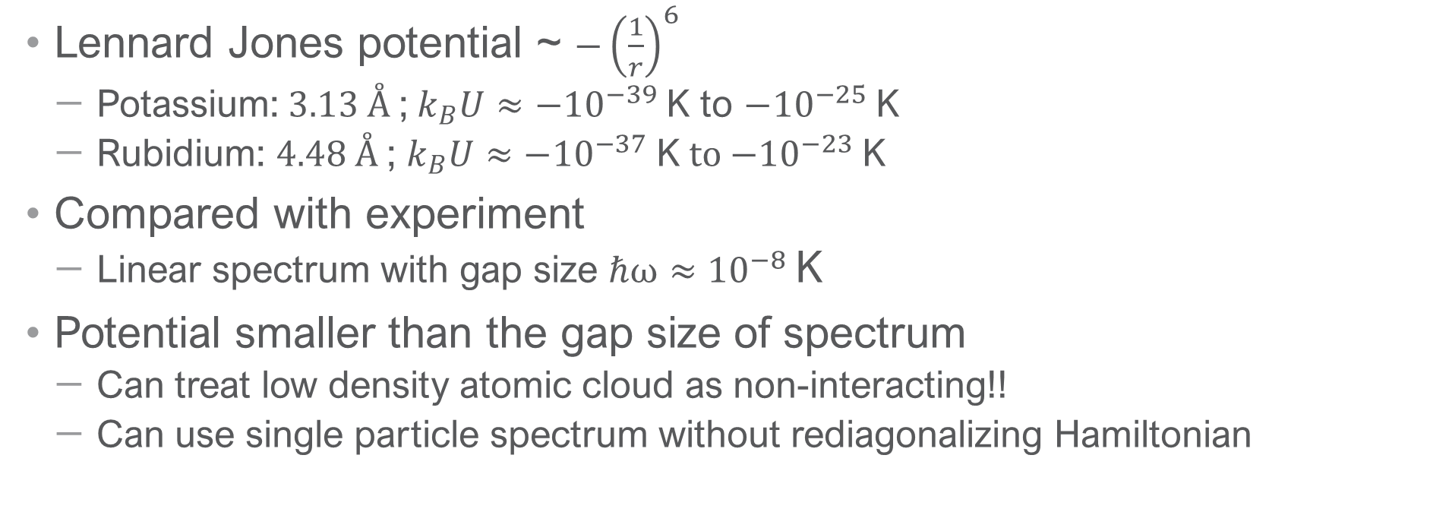
Van der Waals Force of Atomic Cloud
Lennard Jones potential ~ $−{\left(\frac{1}{r}\right)}^{6}$
Potassium: 3.13 Å ;${ k}_{B}U≈{−10}^{−39}$K to $−{10}^{−25}$K
Rubidium: 4.48 Å ; $k_{B}U≈−{10}^{−37}$K to $−{10}^{−23}$K
Compared with experiment
Linear spectrum with gap size $ℏω≈{10}^{−8}$K
Potential smaller than the gap size of spectrum
Can treat low density atomic cloud as non-interacting!!
Can use single particle spectrum without rediagonalizing Hamiltonian
K. Viering. Experiments to Control Atom Number and Phase-Space Density in cold Gases. Ph.D. thesis (2012).
N. Radwell, G. Walker, and S. Franke-Arnold. “Ultra high densities of cold atoms in a holographically controlled dark spot trap.” arXiv:1308.4586 (2013).
Notes:
If we had to do perturbation to get new Hamiltonian, first order correction would go as U, so very small and wouldn’t change the eigenvalues much.
Also, there’s no crossing of energy levels so we can neglect any changes from these interactions
S-wave scatter: low density, so low probability that the particles would interact.

Slide 7
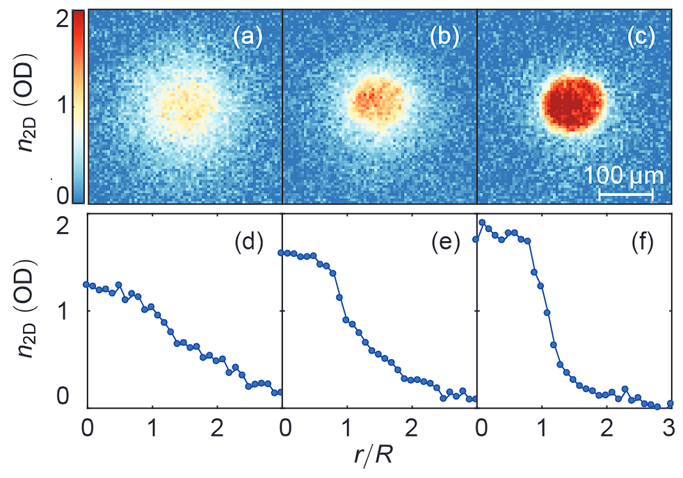
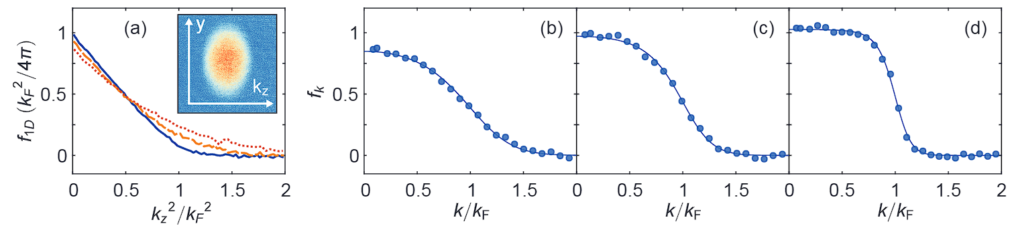
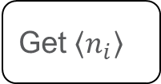
Atomic Gas
Measure via TOF
Get p(v)
Get $\left\langle n_{i}\right\rangle$
Fit to statistical ensemble
Temp
Measurements taken via time of flight (TOF)
Probability distribution of velocity used to extract the single particle occupation numbers
T. M. Brzozowski, M. Maczynska, M. Zawada, J. Zachorowski, and W. Gawlik. “Time-of-flight measurement of the temperature of cold atoms for short trap probe beam distances.” Journal of Optics B: Quantum and Semiclassical Optics 4, 62 (2002).
Mukherjee et. al. (2017). Homogeneous Atomic Fermi Gases. 10.1103/physrevlett.118.123401
Notes:
Main thing: use TOF (semiclassical approach) to get the single particle energy states
Figure 1: 10 ms TOF

Slide 8
Contents
Cold Atom Experiments
Statistical Mechanics of Non-Interacting Identical particles
Recursive Solutions
Results
Conclusion

Slide 9
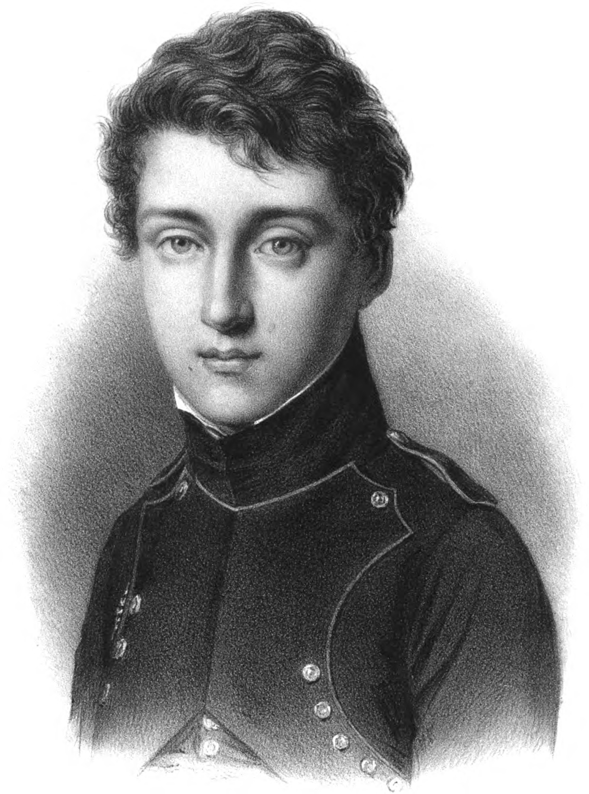
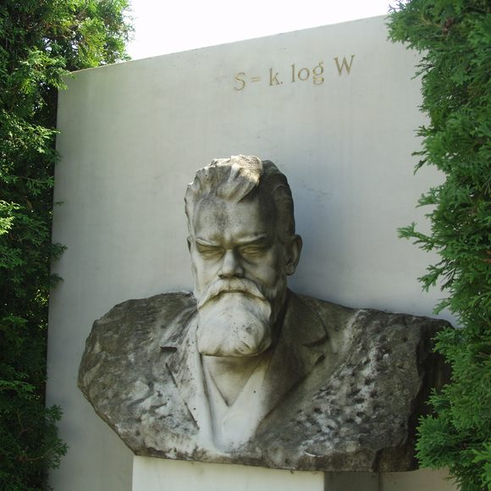
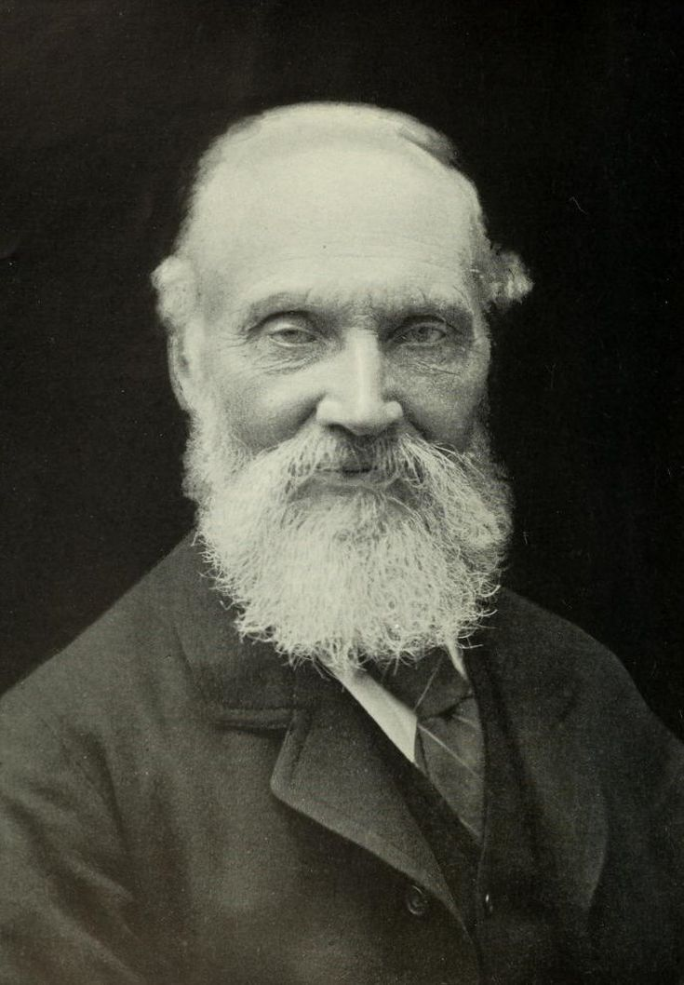
Statistical Mechanics
Statistical mechanics describes how new behavior emerges in matter from many degrees of freedom.
Historically, studies of heat processes and engines
Testing ground for statistical mechanics
M. Kardar. Statistical Physics of Particles (Cambridge University Press, 2007).

Slide 10
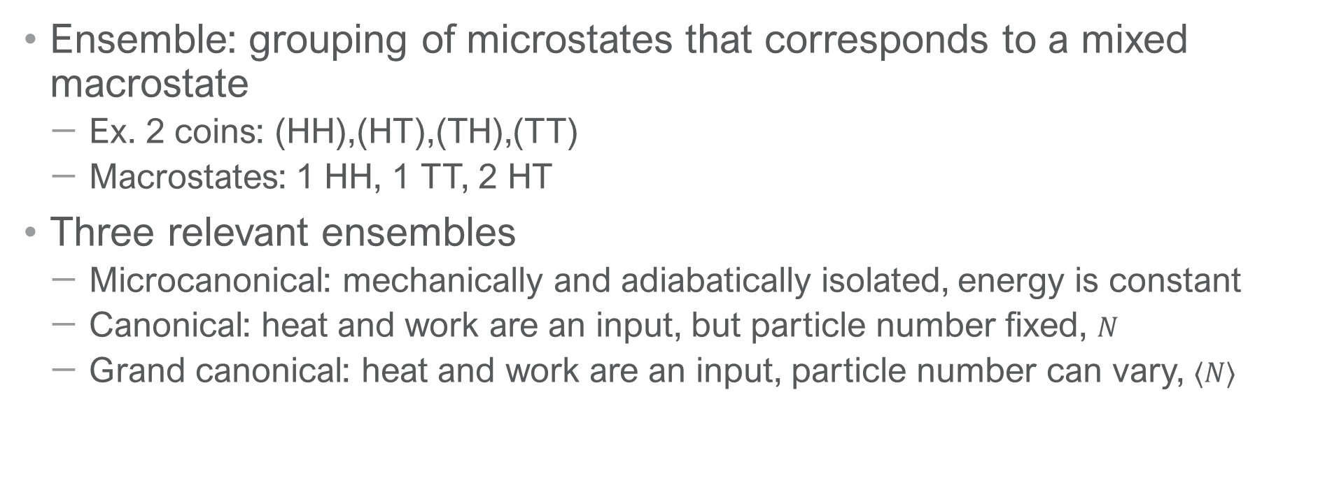
Statistical Ensembles
Ensemble: grouping of microstates that corresponds to a mixed macrostate
Ex. 2 coins: (HH),(HT),(TH),(TT)
Macrostates: 1 HH, 1 TT, 2 HT
Three relevant ensembles
Microcanonical: mechanically and adiabatically isolated, energy is constant
Canonical: heat and work are an input, but particle number fixed, $N$
Grand canonical: heat and work are an input, particle number can vary, $⟨N⟩$
M. Kardar. Statistical Physics of Particles (Cambridge University Press, 2007).
Notes:
Don’t care about microcanonical because we have a potential applied (work being done) by lasers
In general, GC avg particle known, but not fixed
Reiterate, canonical is what’s correct

Slide 11
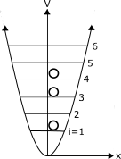
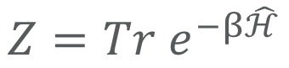
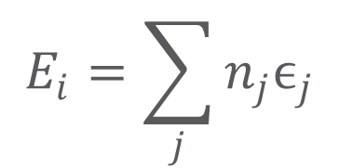
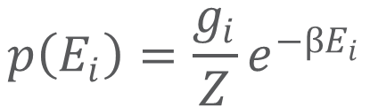
The Partition Function
$$Z=Tr e^{−β\hat{ℋ}}$$
$$p\left(E_{i}\right)=\frac{g_{i}}{Z}e^{−βE_{i}}$$
Function of thermodynamic state variables that is defined as a sum over all the states of Boltzmann factors
Normalization factor
Used to derive thermodynamical properties
Internal energy, specific heat
Non-interacting identical particles condition
Partition function can be constructed from single particle energy states
$$E_{i}=\sum_{j}{n_{j}ϵ_{j}}$$
S. J. Blundell and K. M. Blundell. Concepts in Thermal Physics (Oxford University Press, 2010)
Notes:
Hamiltonian of the whole system, not single particle states
Talk about n_i the occupation number, example
E is a the energy you get from acting on the many body wave function.
G_i is degeneracy

Slide 12
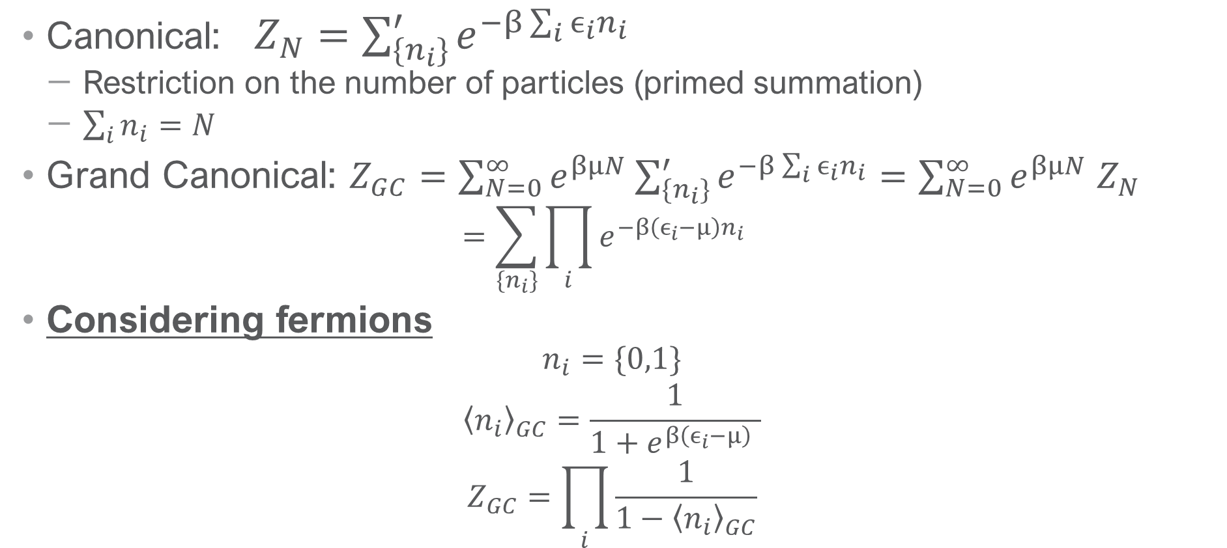
Partition Function Calculations
Canonical: $Z_{N}=\sum_{\{n_{i}\}}^{′}{e^{−β\sum_{i}{ϵ_{i}n_{i}}}}$
Restriction on the number of particles (primed summation)
$\sum_{i}{n_{i}}=N$
Grand Canonical: $Z_{GC}=\sum_{N=0}^{∞}{e^{βμN}\sum_{\{n_{i}\}}^{′}{e^{−β\sum_{i}{ϵ_{i}n_{i}}}}}=\sum_{N=0}^{∞}{e^{βμN}{ Z}_{N}}$
$$=\sum_{\{n_{i}\}}{\prod_{i}{e^{−β\left(ϵ_{i}−μ\right)n_{i}} } }$$
Considering fermions
$$n_{i}=\{0,1\}$$
$${\left\langle n_{i}\right\rangle }_{GC}=\frac{1}{1+e^{β\left(ϵ_{i}−μ\right)} }$$
$$Z_{GC}=\prod_{i}{\frac{1}{{1−\left\langle n_{i}\right\rangle }_{GC}}}$$
Notes:
Restricted to fermions, so pauli exclusion principle

Slide 13
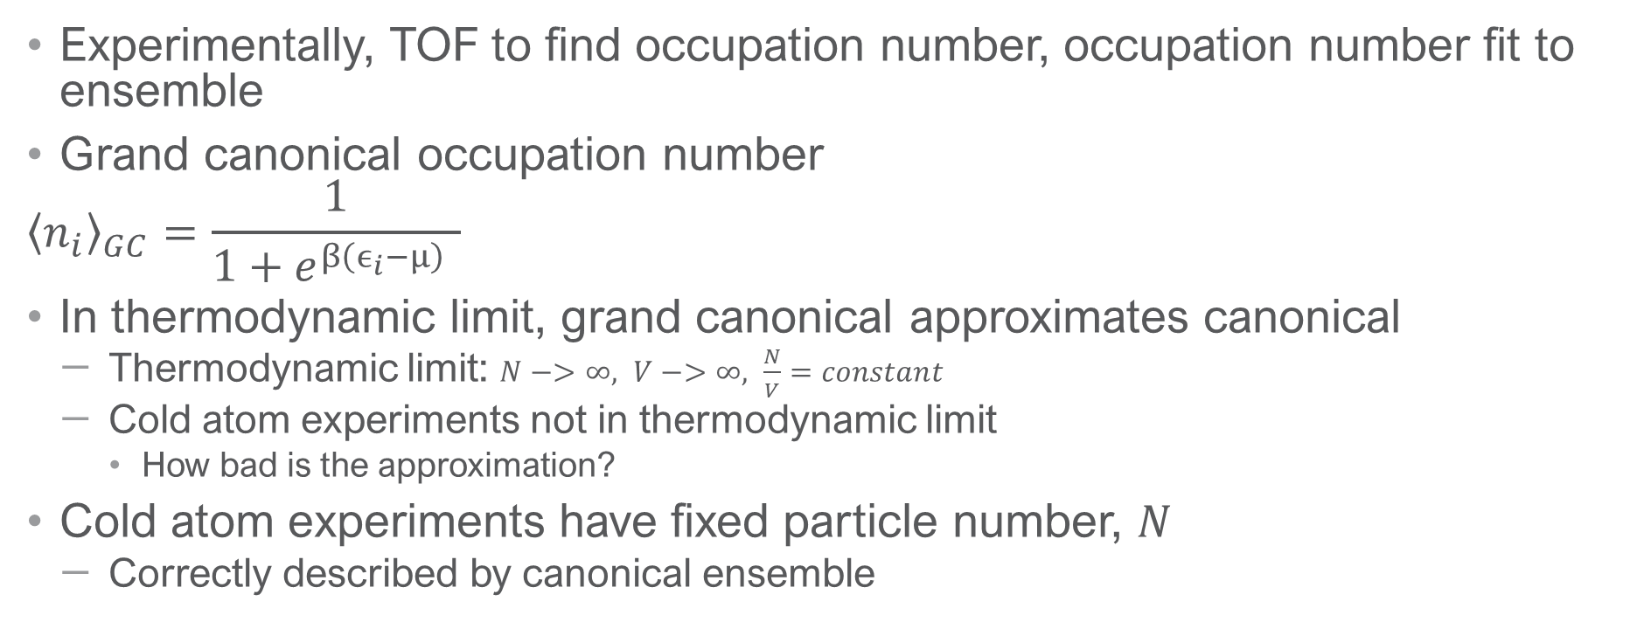
Temperature Extraction via Occupation Numbers
Experimentally, TOF to find occupation number, occupation number fit to ensemble
Grand canonical occupation number
$${\left\langle n_{i}\right\rangle }_{GC}=\frac{1}{1+e^{β\left(ϵ_{i}−μ\right)} }$$
In thermodynamic limit, grand canonical approximates canonical
Thermodynamic limit: $N−>∞, V−>∞, \frac{N}{V}=constant$
Cold atom experiments not in thermodynamic limit
How bad is the approximation?
Cold atom experiments have fixed particle number, $N$
Correctly described by canonical ensemble
Mukherjee et. al. (2017). Homogeneous Atomic Fermi Gases. 10.1103/physrevlett.118.123401
Notes:
Mathematical formalism easier for GC
Large beta bring the discreteness of spectra and put us in quantum regime
Fitting n to occupation number then getting mu and beta^*
This is okay in thermodynamic limit
Careful when saying canonical or grand canonical
Go slowly and think

Slide 14
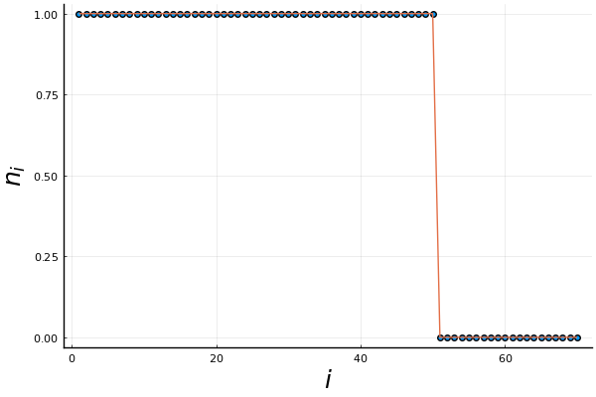
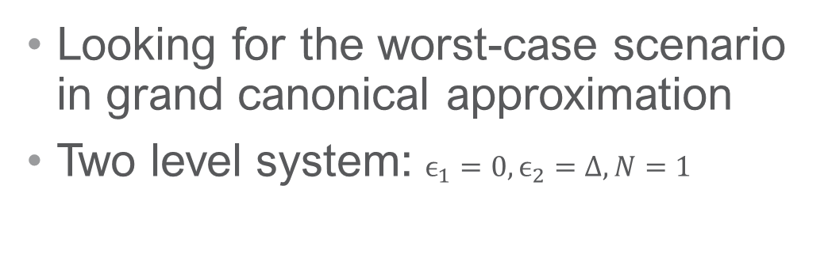
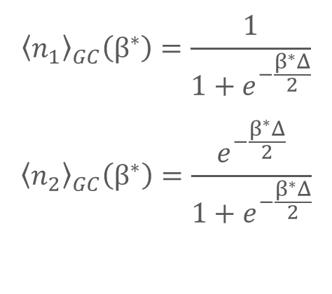
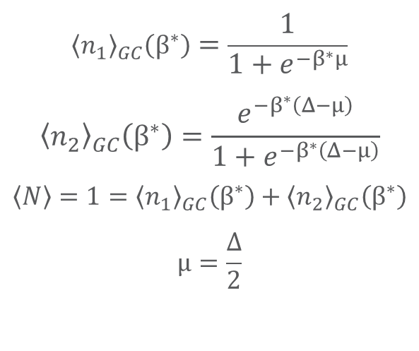
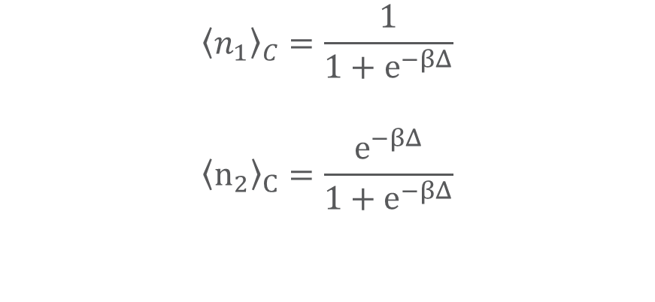
Simple Example
Looking for the worst-case scenario in grand canonical approximation
Two level system: $ϵ_{1}=0,ϵ_{2}=Δ,N=1$
Grand Canonical
Canonical
$${\left\langle n_{1}\right\rangle }_{GC}\left(β^{∗}\right)=\frac{1}{1+e^{−β^{∗}μ}}$$
$${\left\langle n_{2}\right\rangle }_{GC}\left(β^{∗}\right)=\frac{e^{−β^{∗}\left(Δ−μ\right)}}{1+e^{−β^{∗}\left(Δ−μ\right)}}$$
$$\left\langle N\right\rangle =1={\left\langle n_{1}\right\rangle }_{GC}\left(β^{∗}\right)+{\left\langle n_{2}\right\rangle }_{GC}\left(β^{∗}\right)$$
$$μ=\frac{Δ}{2}$$
$${\left\langle n_{1}\right\rangle }_{GC}\left(β^{∗}\right)=\frac{1}{1+e^{−\frac{β^{∗}Δ}{2}}}$$
$${\left\langle n_{2}\right\rangle }_{GC}\left(β^{∗}\right)=\frac{e^{−\frac{β^{∗}Δ}{2}}}{1+e^{−\frac{β^{∗}Δ}{2}}}$$
$${\left\langle n_{1}\right\rangle }_{C}=\frac{1}{1+e^{−βΔ}}$$
$${\left\langle n_{2}\right\rangle }_{C}=\frac{e^{−βΔ}}{1+e^{−βΔ}}$$
Notes:
Lead off with system, not picture
Shift the whole spectrum by a constant
will affect partition function
won’t affect the occupation probabilities

Slide 15
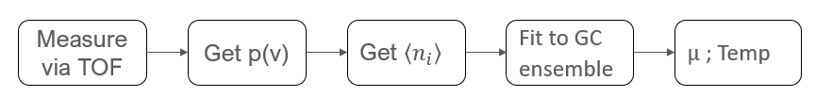
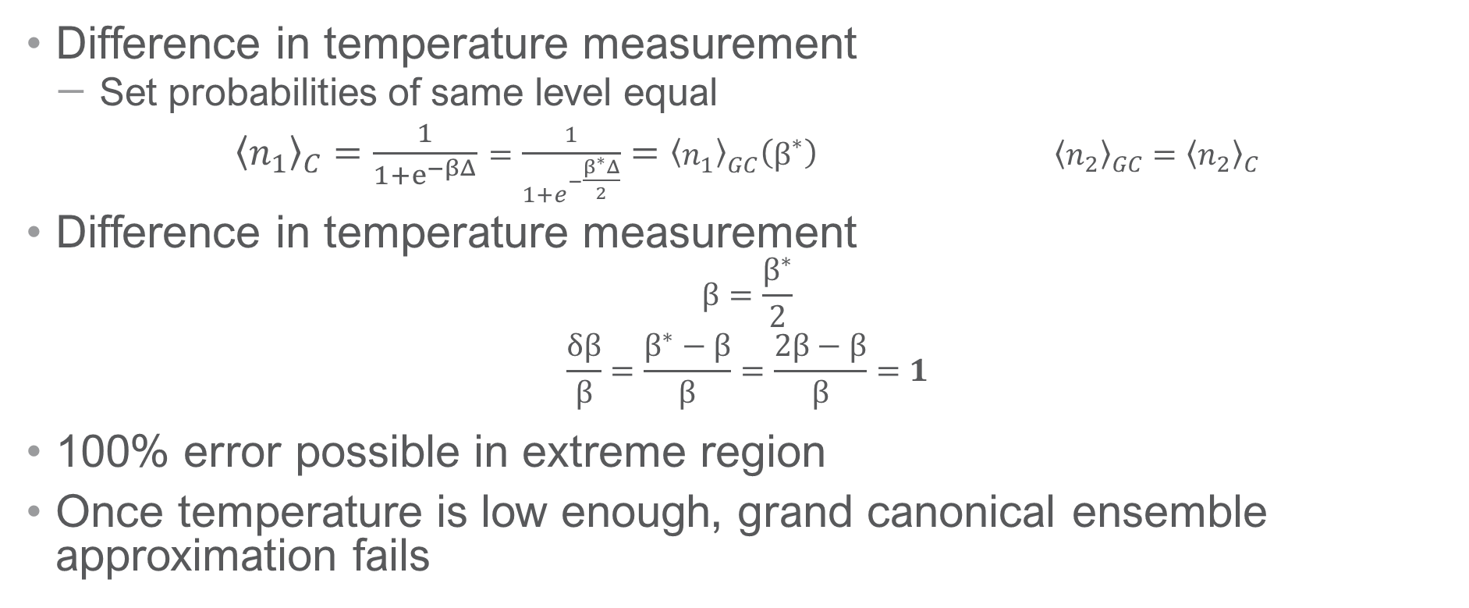
Simple Example
Difference in temperature measurement
Set probabilities of same level equal
${\left\langle n_{1}\right\rangle }_{C}=\frac{1}{1+e^{−βΔ}}=\frac{1}{1+e^{−\frac{β^{∗}Δ}{2}}}={\left\langle n_{1}\right\rangle }_{GC}\left(β^{∗}\right)$ ${\left\langle n_{2}\right\rangle }_{GC}={\left\langle n_{2}\right\rangle }_{C}$
Difference in temperature measurement
$$β=\frac{β^{∗}}{2}$$
$$\frac{δβ}{β}=\frac{β^{∗}−β}{β}=\frac{2β−β}{β}=1$$
100% error possible in extreme region
Once temperature is low enough, grand canonical ensemble approximation fails
Notes:
Beta is inverse temp so the actual temperature is 2T_GC
Find pictures from TOF?
Mention that the 100% error will be seen again
At low temp can’t describe the system because we see the quantum effects

Slide 16
Contents
Cold Atom Experiments
Statistical Mechanics of Non-Interacting Identical particles
Recursive Solutions
Results
Conclusion

Slide 17
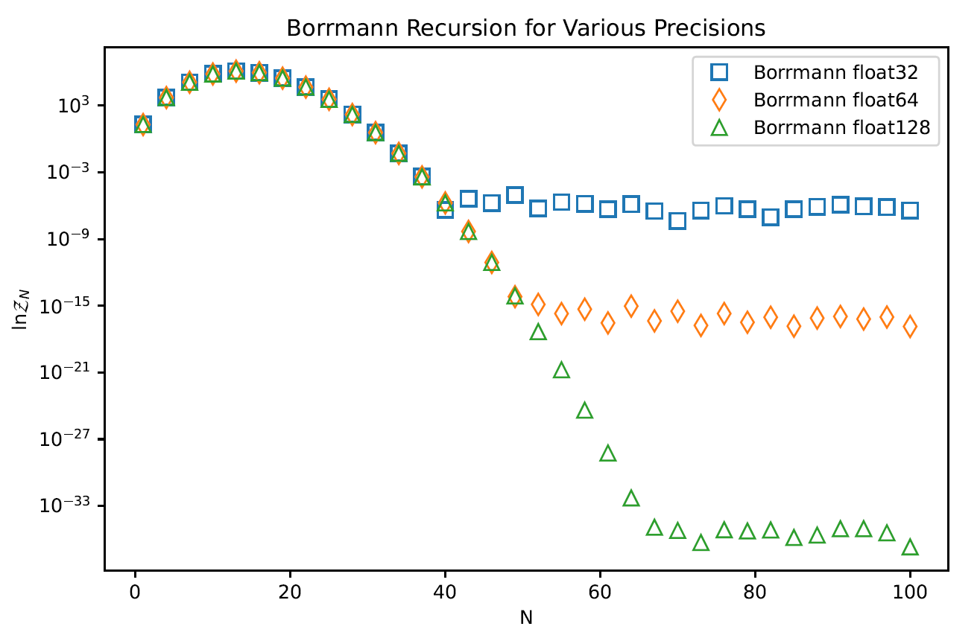
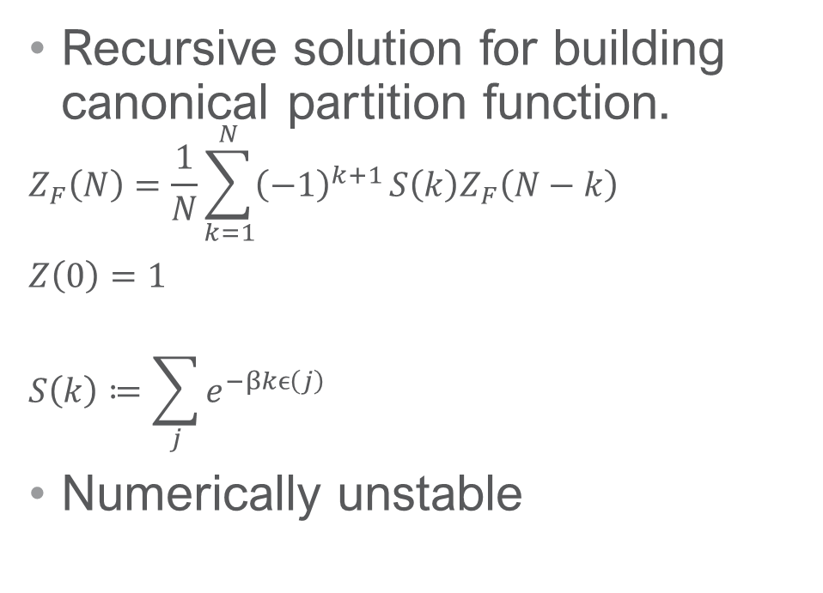
Borrmann’s method
Recursive solution for building canonical partition function.
$$Z_{F}\left(N\right)=\frac{1}{N}\sum_{k=1}^{N}{{\left(−1\right)}^{k+1}}S\left(k\right)Z_{F}\left(N−k\right)$$
$Z\left(0\right)=1$
$$S\left(k\right)≔\sum_{j}{e^{−βkϵ\left(j\right)}}$$
Numerically unstable
P. Borrmann and G. Franke. “Recursion formulas for quantum statistical partition functions.” The Journal of Chemical Physics 98, 2484 (1993).
Notes:
Don’t mention QMC
Alternating summation

Slide 18
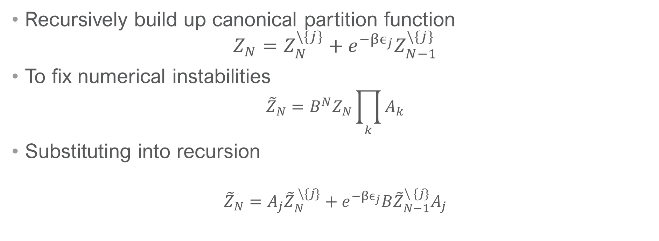
Auxiliary Partition Function (APF) Method
Recursively build up canonical partition function
$$Z_{N}=Z_{N}^{\backslash \{j\}}+e^{−βϵ_{j}}Z_{N−1}^{\backslash \{j\}}$$
To fix numerical instabilities
$${\tilde{Z}}_{N}=B^{N}Z_{N}\prod_{k}{A_{k}}$$
Substituting into recursion
$${\tilde{Z}}_{N}=A_{j}{\tilde{Z}}_{N}^{ \backslash \{j\}}+e^{−βϵ_{j}}B{\tilde{Z}}_{N−1}^{\backslash \{j\}}A_{j}$$
Level j excluded from sum
H. Barghathi, J. Yu, and A. Del Maestro. “Theory of noninteracting fermions and bosons in the canonical ensemble.” Physical Review Research 2, 043206 (2020).
Notes:
Recursion allows you to add energy levels one by one
Borrmann’s solution is a natural consequence of this
Make sure to say if you divide by Z_N then you get occ prob and compl occ prob
-1 problem is gone now

Slide 19
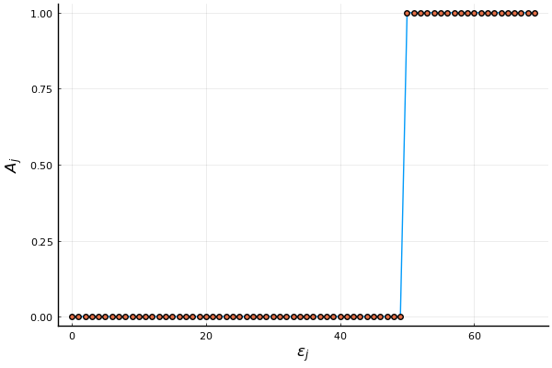
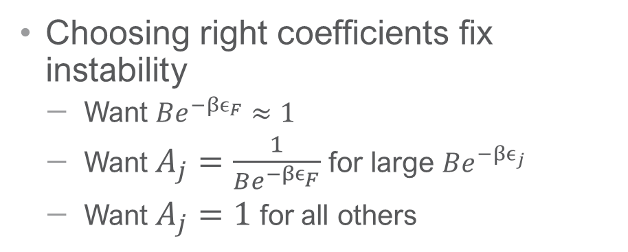
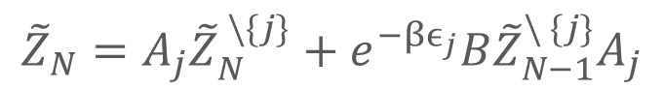
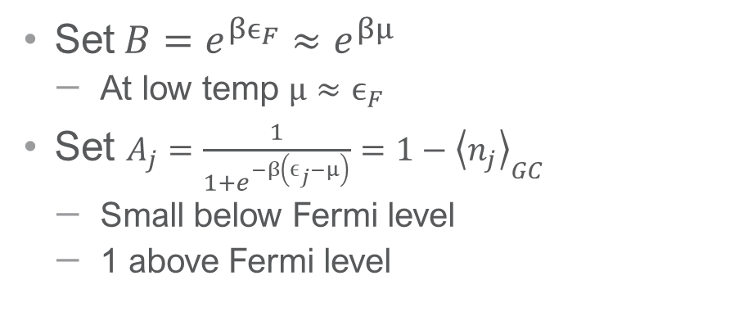
Scaling
Set $B={e^{βϵ_{F}}≈e}^{βμ}$
At low temp $μ≈ϵ_{F}$
Set $A_{j}=\frac{1}{1+e^{−β\left(ϵ_{j}−μ\right)}}=1−{\left\langle n_{j}\right\rangle }_{GC}$
Small below Fermi level
1 above Fermi level
$${\tilde{Z}}_{N}=A_{j}{\tilde{Z}}_{N}^{ \backslash \{j\}}+e^{−βϵ_{j}}B{\tilde{Z}}_{N−1}^{\backslash \{j\}}A_{j}$$
Choosing right coefficients fix instability
Want $Be^{−βϵ_{F}}≈1$
Want $A_{j}=\frac{1}{Be^{−βϵ_{F}}}$for large $Be^{−βϵ_{j}}$
Want $A_{j}=1$ for all others
Notes:
Could choose B and A_j many ways, but want physical meaning to our choices
A_j is the occupation in the associated grand canonical ensemble
Consider “A” GCE not “THE”
Using it to help us out

Slide 20
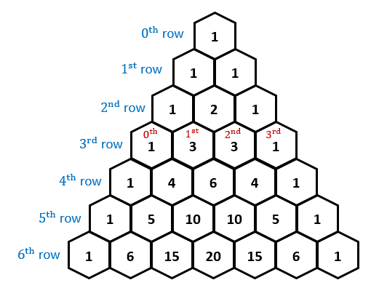
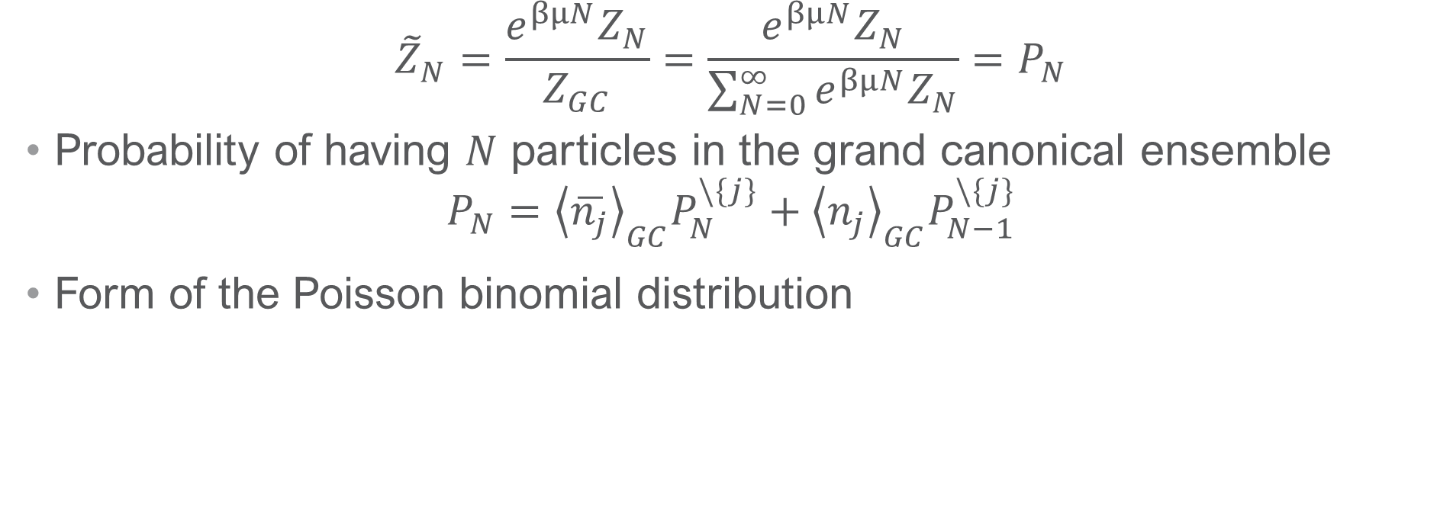
Particle Number Distribution
$${\tilde{Z}}_{N}=\frac{e^{βμN}Z_{N}}{Z_{GC}}=\frac{e^{βμN}Z_{N}}{\sum_{N=0}^{∞}{e^{βμN}Z_{N}}}=P_{N}$$
Probability of having $N$ particles in the grand canonical ensemble
$$P_{N}={\left\langle \overline{n_{j}}\right\rangle }_{GC}P_{N}^{\backslash \{j\}}+{\left\langle n_{j}\right\rangle }_{GC}P_{N−1}^{\backslash \{j\}}$$
Form of the Poisson binomial distribution
Notes:
Grand canonical of the “fictitious” associated distribution
Using grand canonical to control the numerics
Not using or fitting to grand canonical
Part num dist is a pb dist
What we want is Z_N so we’re using the associated grand canonical ensemble to find it
Another way of calculating the particle number distribution(interesting!)
Know how to construct all

Slide 21
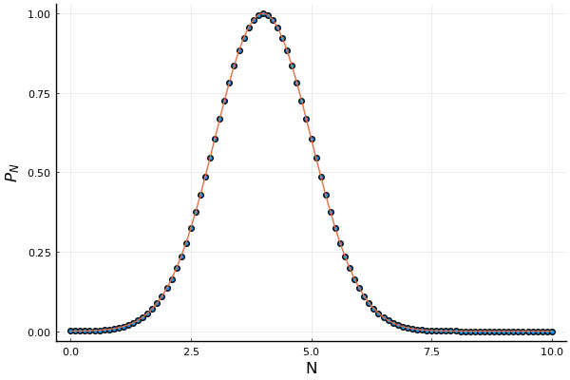
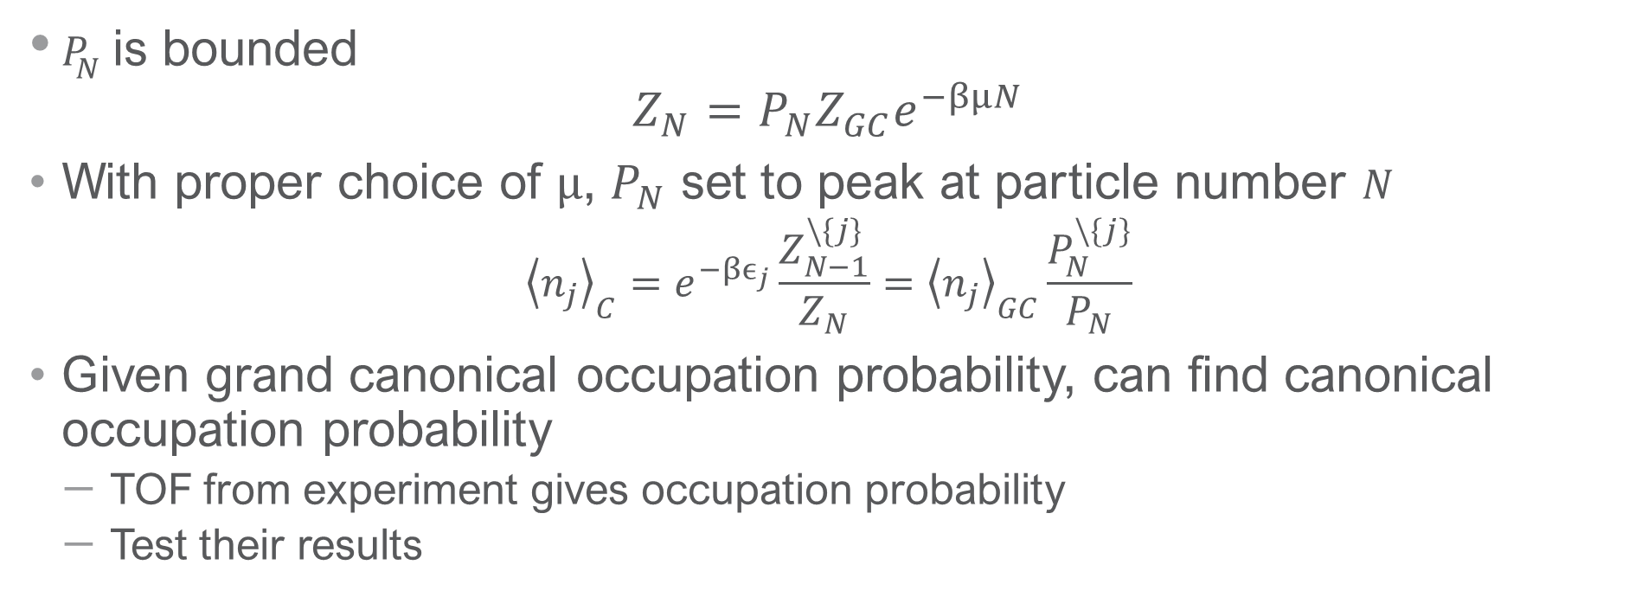
APF Recursion Relation
$P_{N}$ is bounded
$$Z_{N}=P_{N}Z_{GC}e^{−βμN}$$
With proper choice of $μ$, $P_{N}$ set to peak at particle number $N$
$${\left\langle n_{j}\right\rangle }_{C}=e^{−βϵ_{j}}\frac{Z_{N−1}^{\backslash \{j\}}}{Z_{N}}={\left\langle n_{j}\right\rangle }_{GC}\frac{P_{N}^{\backslash \{j\}}}{P_{N}}$$
Given grand canonical occupation probability, can find canonical occupation probability
TOF from experiment gives occupation probability
Test their results
Notes:
With the weights chosen (mu), the distribution peaks at N
Z_GC easy to compute, have PN recursion relation now, and
Asymptotically P(N) is peaked at N particles
Don’t need ZN now to find occupation probabilities
Get canon occ from made up grand canon occ prob
Test the grand canonical approximation
Can test this for 1d SHO
N_GC isn’t the experimental occ prob

Slide 22

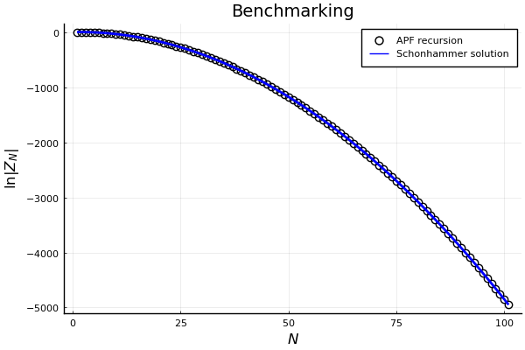
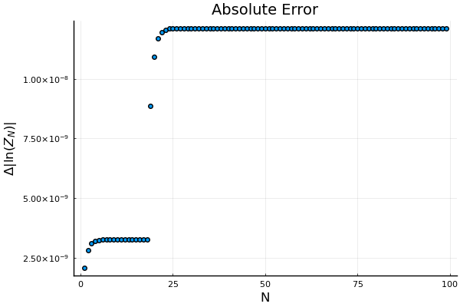
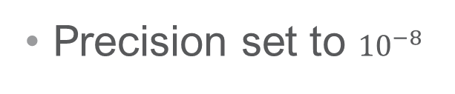
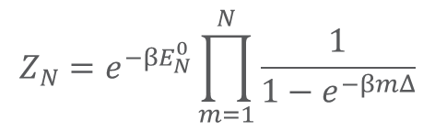
Benchmarking
$$Z_{N}=e^{−βE_{N}^{0}}\prod_{m=1}^{N}{\frac{1}{1−e^{−βmΔ}}}$$
Precision set to ${10}^{−8}$
K. Sch¨onhammer. “Thermodynamics and occupation numbers of a fermi gas in the canonical ensemble.” American Journal of Physics 68, 1032–1037 (2000). Recursive relationship for lin E spectrum and occupation prob discussion for can and gc.
H. Barghathi, J. Yu, and A. Del Maestro. “Theory of noninteracting fermions and bosons in the canonical ensemble.” Physical Review Research 2, 043206 (2020).
Notes:
Test for the recursion relation with the exact results from schonhammer
Showing the numerical stability of this method
Don’t talk about the jump in the graph
Prof.Dr.Schonhammer
Bound on the error.
We can control accuracy

Slide 23
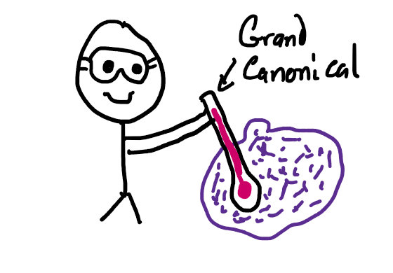
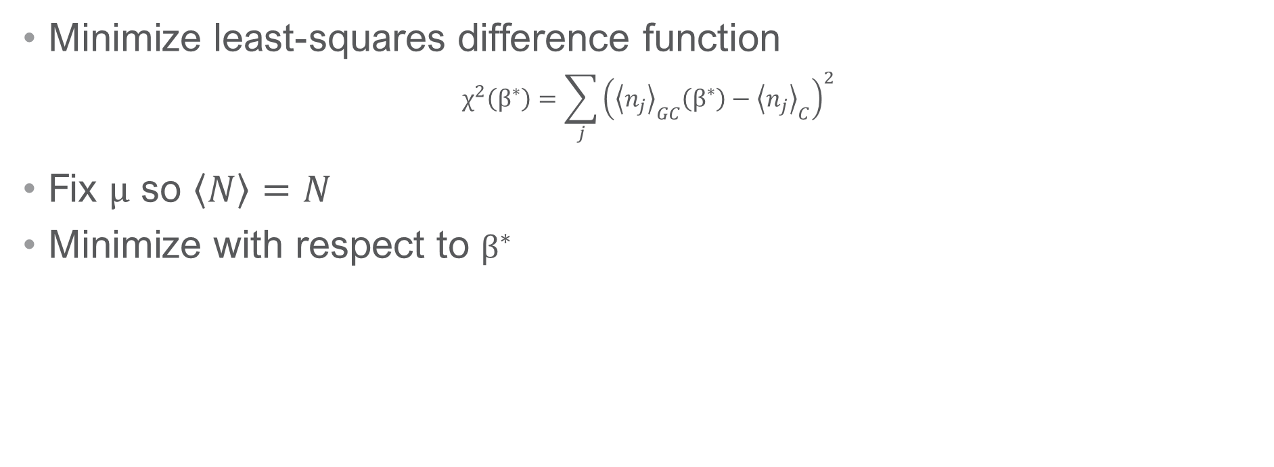
Temperature Extraction
Minimize least-squares difference function
$$χ^{2}\left(β^{∗}\right)=\sum_{j}{{\left({\left\langle n_{j}\right\rangle }_{GC}\left(β^{∗}\right)−{\left\langle n_{j}\right\rangle }_{C}\right)}^{2}}$$
Fix $μ$ so $\left\langle N\right\rangle =N$
Minimize with respect to $β^{∗}$
Notes:
Remotivate
We have the correct canonical occ probs
Given this, if treated GC, what error would be made
Quantify error using chi squared
One free parameter is beta^*
How incorrect is the beta^* from beta
What is the minimum error that experimentalists will make
Beta* effective temp in GC
n_j_C is the experimental spectrum

Slide 24
Contents
Cold Atom Experiments
Statistical Mechanics of Non-Interacting Identical particles
Recursive Solutions
Results
Conclusion

Slide 25
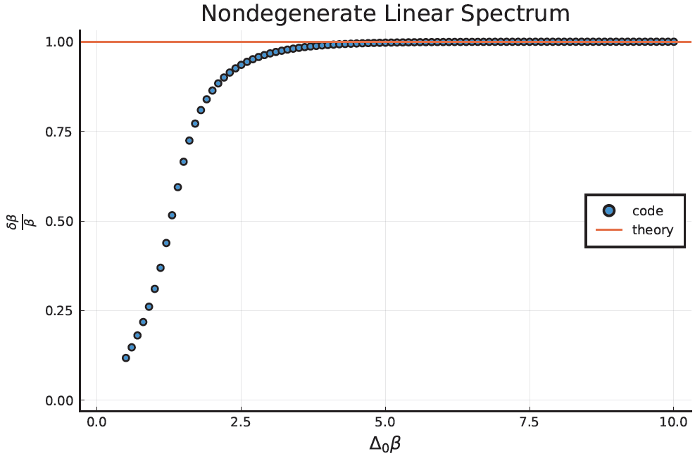
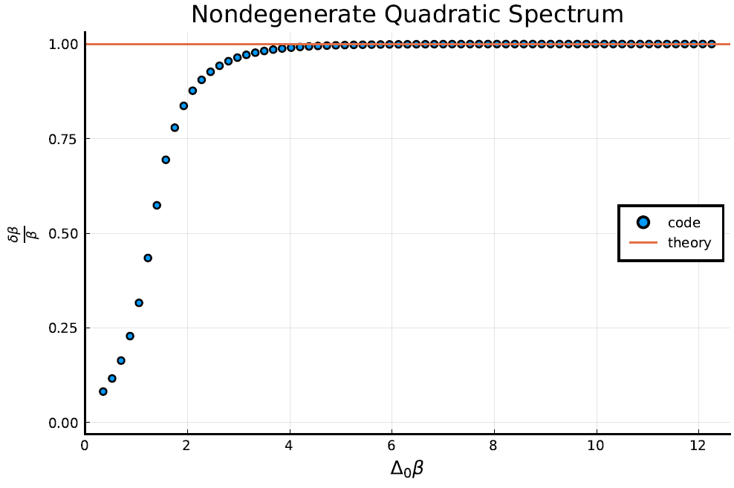
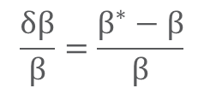
Numerical Results
$$\frac{δβ}{β}=\frac{β^{∗}−β}{β}$$
Linear spectrum
Quadratic Spectrum
Notes:
“Here I only cover two cases, but if you look in the thesis, I explore other cases where this error would be large”
10 particles, but it doesn’t matter since only relevant levels will be at fermi level and 1st excited state
Delta for Quad is 6.333

Slide 26
Contents
Cold Atom Experiments
Statistical Mechanics of Non-Interacting Identical particles
Recursive Solutions
Results
Conclusion

Slide 27
Conclusion
Have a stable recursive method for calculating canonical partition function from occupation probabilities
Occupation probabilities measured from TOF in experiment
Utilize APF method to build up partition function
Identify a regime of temp where grand canonical fails to extract temperature from cold atoms
Future work
Apply to canonical quantum Monte Carlo
Collaborate with experimentalists to test real data
Notes:
This is a DOE funded project so need to mention QMC

Slide 28
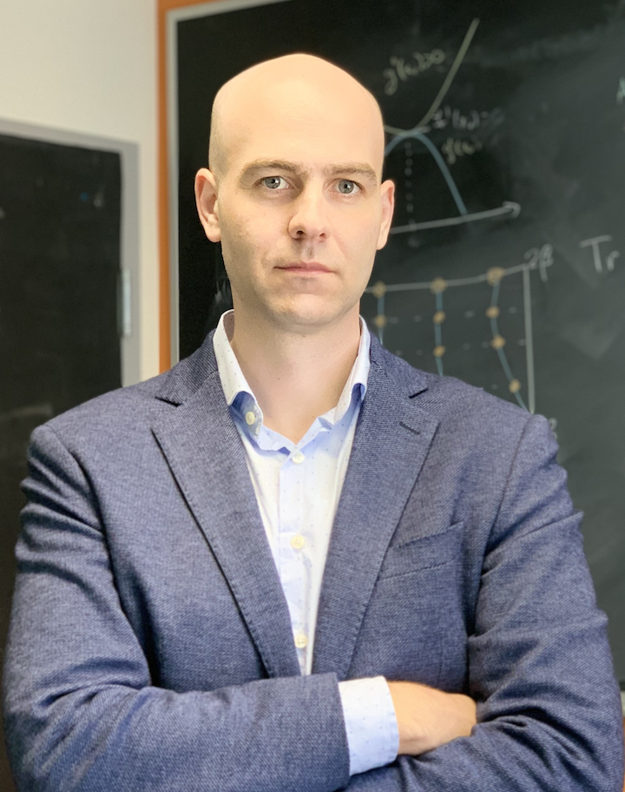

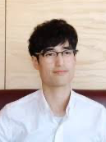




Acknowledgements
Professor Adrian Del Maestro
Dr. Hatem Barghathi
The Del Maestro Group
U.S Department of Energy, Office of Science, Office of Basic Energy Sciences, Award Number DE-SC0022311
https://github.com/csobecks/MSwriteup

Slide 29
Thank you

Slide 30
Backup Slides

Slide 31
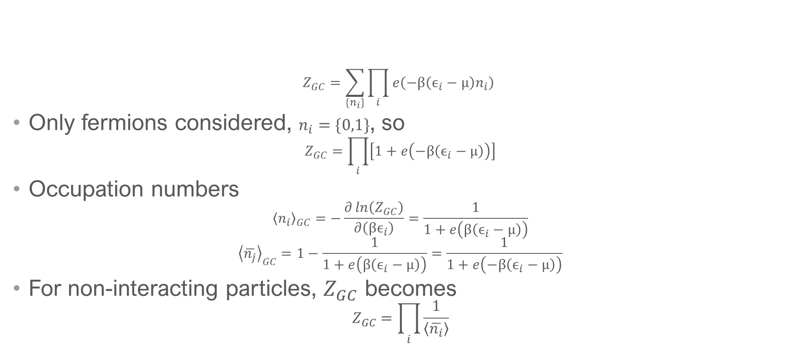
Grand Canonical Partition Function
$$Z_{GC}=\sum_{\{n_{i}\}}{\prod_{i}{e\left(−β\left(ϵ_{i}−μ\right)n_{i}\right)} }$$
Only fermions considered, $n_{i}=\{0,1\}$, so
$$Z_{GC}=\prod_{i}{\left[1+e\left(−β\left(ϵ_{i}−μ\right)\right)\right]}$$
Occupation numbers
$${\left\langle n_{i}\right\rangle }_{GC}=−\frac{∂\ln\left(Z_{GC}\right)}{∂\left(βϵ_{i}\right)}=\frac{1}{1+e\left(β\left(ϵ_{i}−μ\right)\right)}$$
$${\left\langle \overline{n_{j}}\right\rangle }_{GC}=1−\frac{1}{1+e\left(β\left(ϵ_{i}−μ\right)\right)}=\frac{1}{1+e\left(−β\left(ϵ_{i}−μ\right)\right)}$$
For non-interacting particles, $Z_{GC}$ becomes
$$Z_{GC}=\prod_{i}{\frac{1}{\left\langle \overline{n_{i}}\right\rangle }}$$
Notes:
Don’t mention experiments in this slide
The product of exponentials will get all combinations in the partition function (1+e^E1+e^E1+E2…)
Chemical potential is a function of average num of particles and temperature

Slide 32
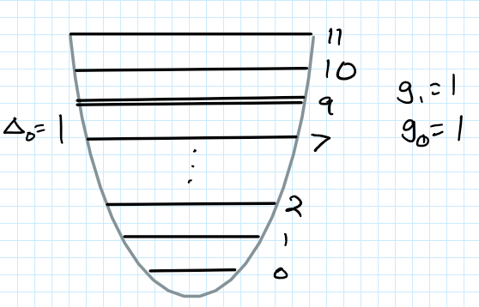


Degeneracy cases
3 cases considered
10 particles
Partially Filled Fermi Level:
Filled Fermi Level
Almost Degenerate Fermi Level:

Slide 33


Filled Degeneracy
$$\frac{δβ}{β}=1−\frac{\ln\left(g_{0}g_{1}\right)}{βΔ_{0}}+\frac{g_{1}g_{0}−1}{βΔ_{0}}e^{−βΔ_{0}}$$
Notes:
Quad delta=7; g_0=2; g_1=1
Lin g_0=2; g_1=1

Slide 34


Filled Degeneracy
$$βΔ_{0}−Δ_{0}δβ=\ln\left(g_{0}g_{1}\right)$$
Notes:
Theory: Ln(2)
Lin: g_0=2 g_1=1
Quad: g_0=2 g_1=1 \Delta_0=7

Slide 35


Partial Filling Degeneracy
$$\frac{δβ}{β}=\frac{1}{βΔ_{0}}\ln\left(\frac{g_{0}−ℓ+1}{g_{0}−ℓ}\right)$$
Notes:
Quad delta_0=7; g0-2 l-1
Lin g0-2 l-1

Slide 36


Partial Filling Degeneracy
$$δβΔ_{0}=\ln\left(\frac{g_{0}−ℓ+1}{g_{0}−ℓ}\right)$$
Notes:
Quad delta_0=7; g0-2 l-1
Lin g0-2 l-1

Slide 37


Almost Degenerate
Notes:
Quad delta_0=6.333; g0-2 l-1
Lin g0-2 l-1

